Slide 1
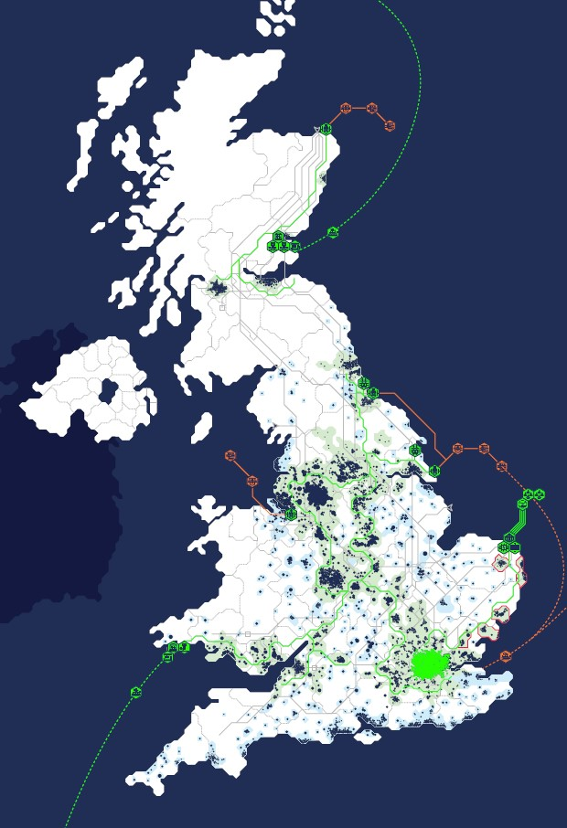
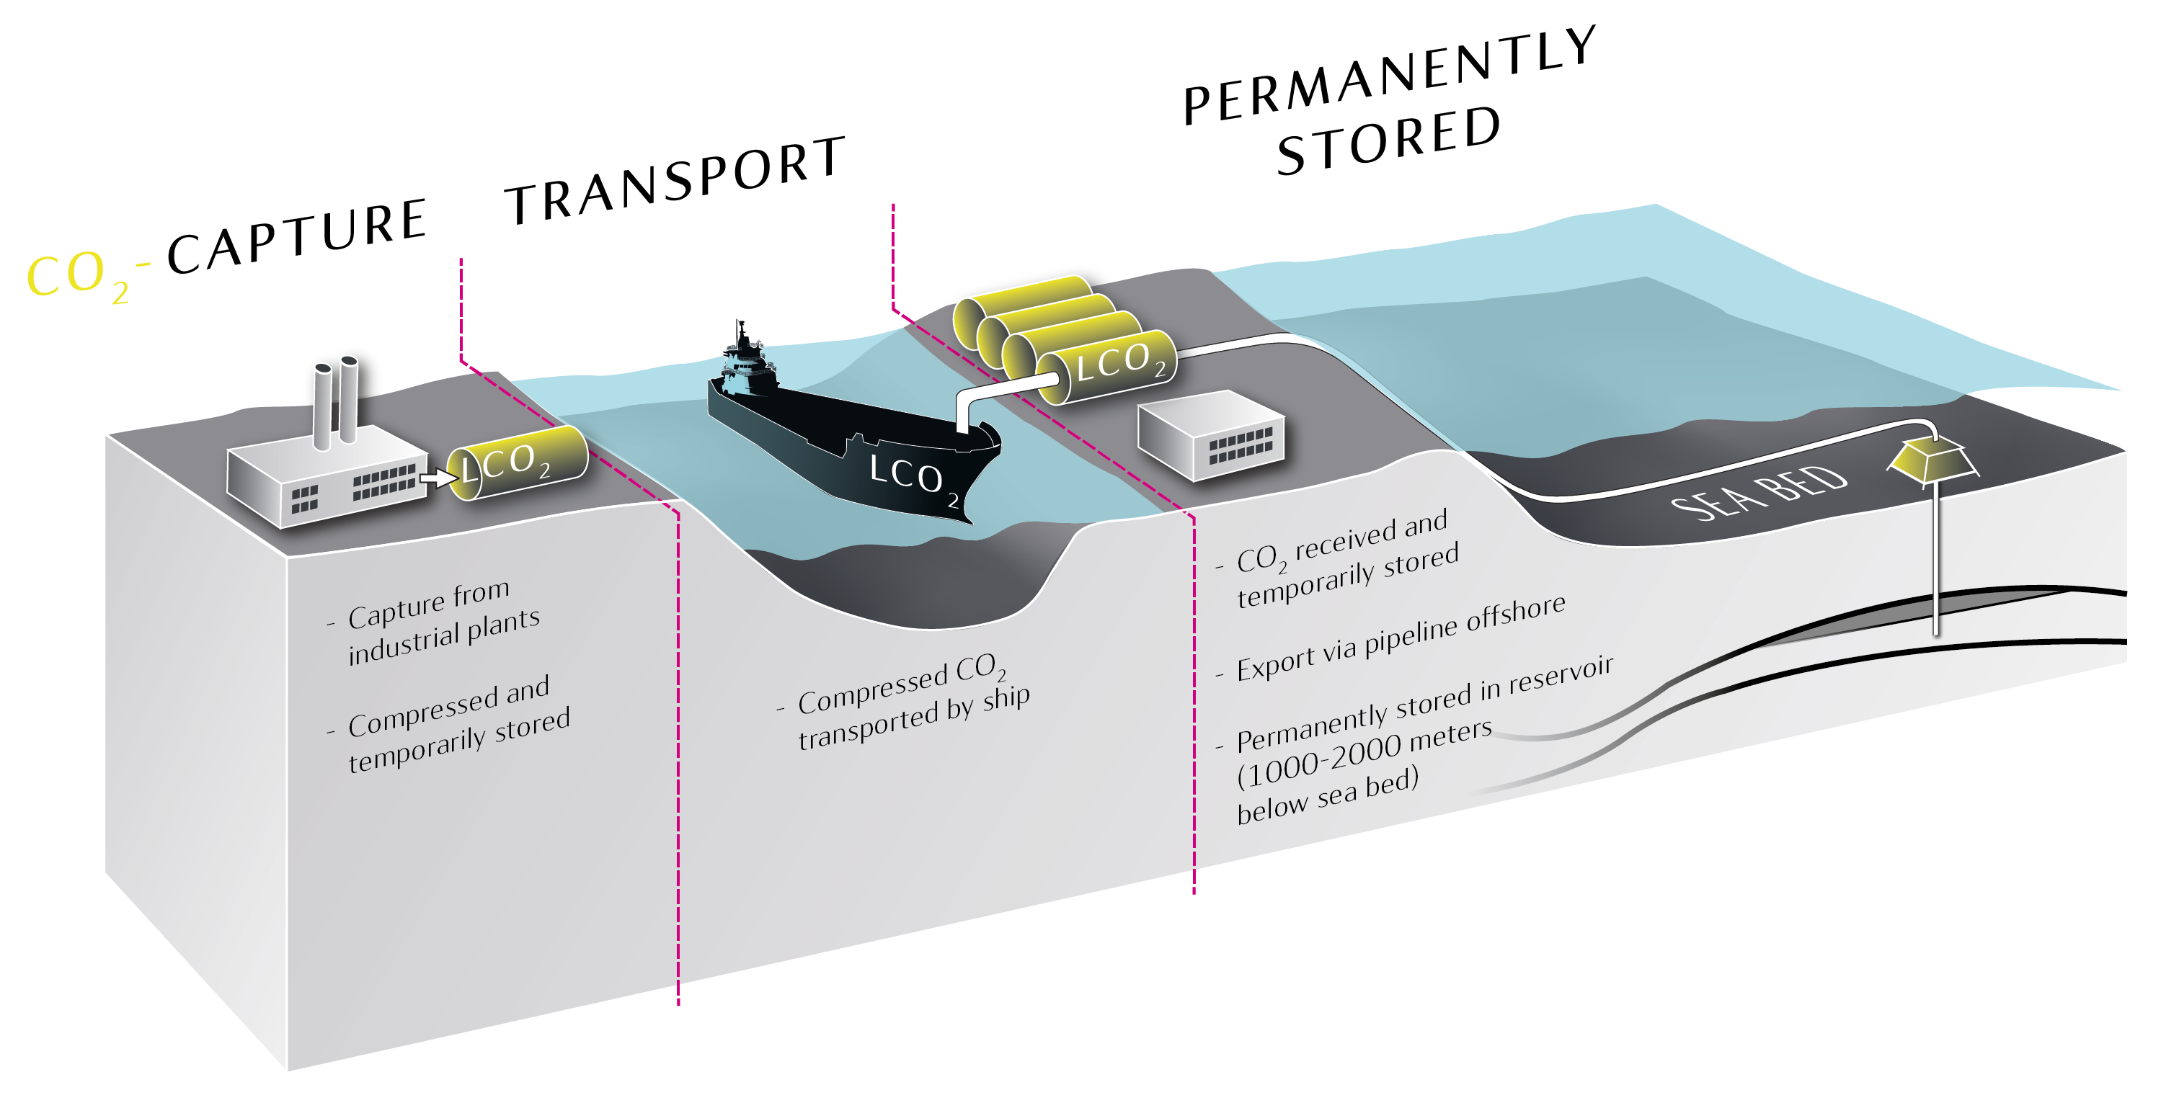
Hydrogen production and CCS
H21 North of England
Henrik Solgaard Andersen – H21 Project Manager
Bryan Lovell Meeting 2019 - London

Slide 2











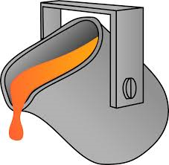

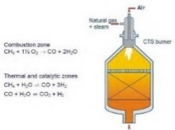



Decarbonising Energy Systems
Easy
complexity to decarbonise
Hard
Battery (mostly)
plus Hydrogen
for Heavy Duty
Hydrogen
Fuel-Cell
Trains
Liquid Hydrogen
and Fuel-Cells for
long haul Big Ships
Transport
Large Battery
Systems
for Daily Swing
(night-to-day)
Hydro-Power as
Battery for Small
Scale Intermittency
Hydrogen fired CCGTs
Clean Back-Up Power
for Large Scale
Intermittency
Power
Light Industry
powered by
Renewable
Heavy Industry
powered by
Hydrogen from
Natural Gas + CCS
CCS for
Industry
without other
Alternatives
Industry
Heat Pumps
For Efficient Use of
Electricity in Homes
Hydrogen for
Efficient Transfer of
Energy from Production
to End-Users
Hydrogen for
Large Scale
Seasonal
Storage
Heat
Multiple technologies to address the challenge
Natural Gas Reforming to Hydrogen with CCS

Slide 3

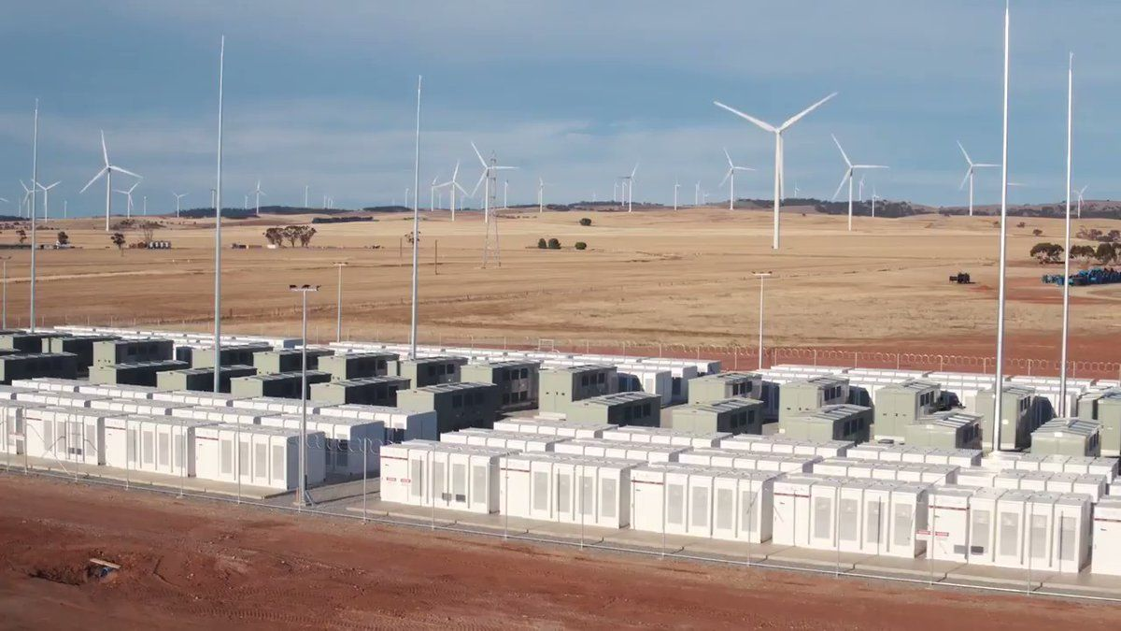

Understanding the Challenge
Natural Gas currently provides Europe with
more than 1500 TWh of inter seasonal flexible energy.
What is 1500 TWh?
Vehicle
Battery park
Hydro
11,600,000 x
20 000 000 000 X
11 600 000 X
200 X
HYDROGEN
to Power Generation
HYDROGEN
to Heat
New Projects
World largest
battery park in Australia (129 MWh)
Norways biggest hydro electrical storage -Blåsjø
TESLA 75D Li-Batteries

Slide 4



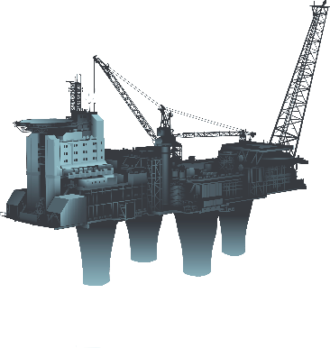
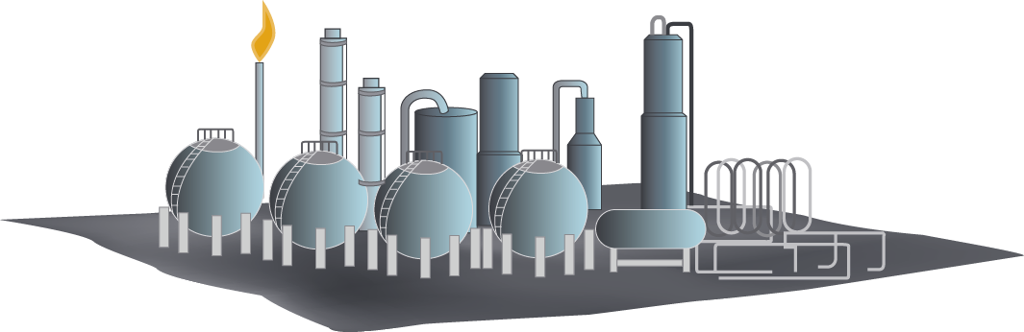

CCS as enabler for hydrogen production
H₂
Clean Hydrogen
        for power
        generation
        for heat
CO₂
        for maritime
        transport
Natural Gas
H₂

Slide 5
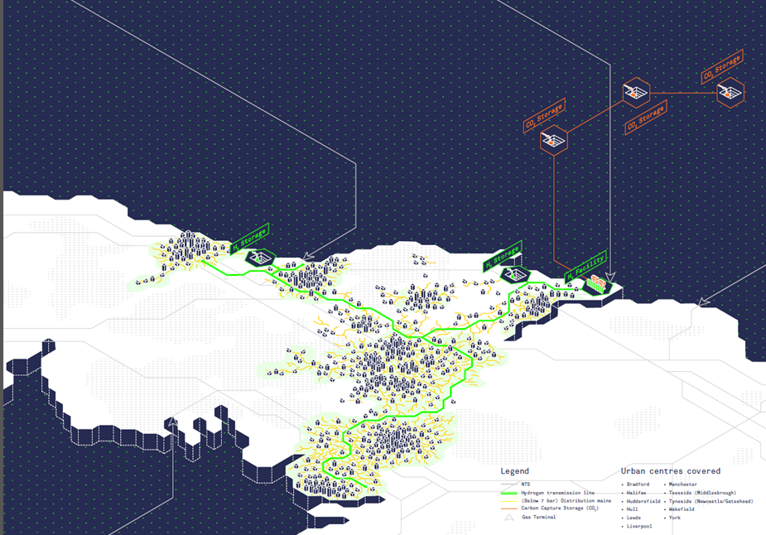
Natural Gas Reforming with CCUS hydrogen supply chains
Proven and referenced technology at scale (TWh-solutions)
Build and commissioned at mega scale
95% CO2 reduction equal to a CO2 footprint of 14-15 g/kWh
Robust and reliable design to meet customers demand
Can deliver credible CO2 reductions for 2030 and 2050 targets
Building upon a strong existing large scale industry

Slide 6
H21 North of England – Meeting the Climate Change Act 2008 based on proven and referenced technology
Key Features
Conversion start 2028 with stepwise expansion to 2035 replacing more than 3.7 million appliances
Resilient design to fulfil security of supply during peak winter (the beast from the east)
Design capacity of 85 TWh
12.5 million CO2 per year avoided
12.1 GW hydrogen production in UK based on reforming of natural gas with CCS
8 TWh inter seasonal hydrogen storage in salt caverns in UK
Offshore CO2 storage in either UK or Norway
CO2 footprint: 14.47 g/kWh

Slide 7
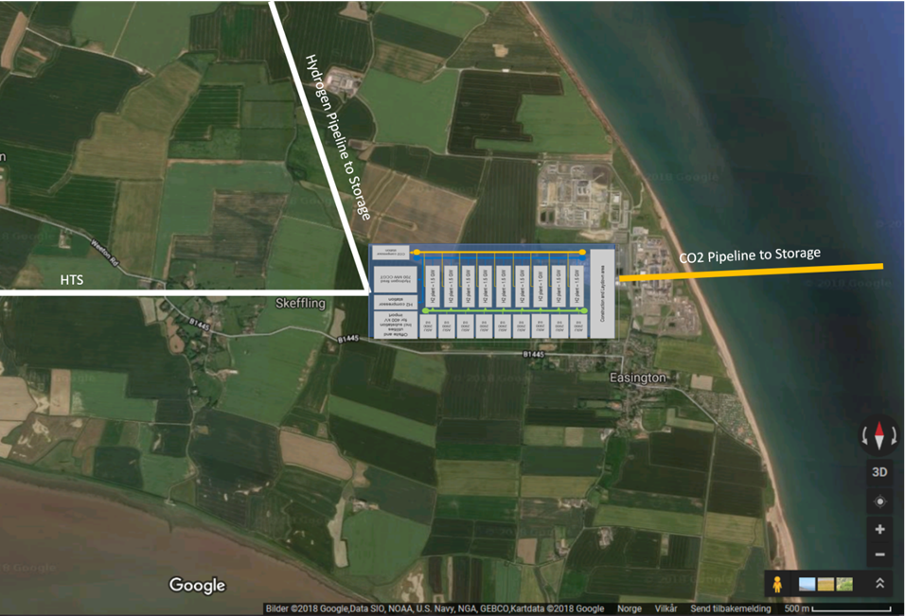
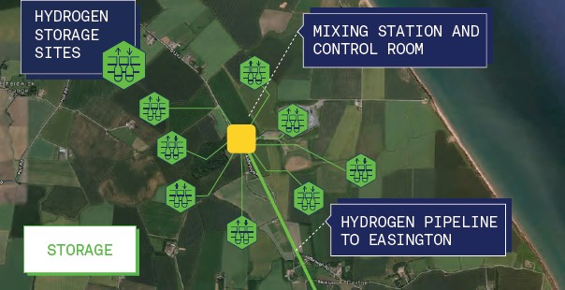
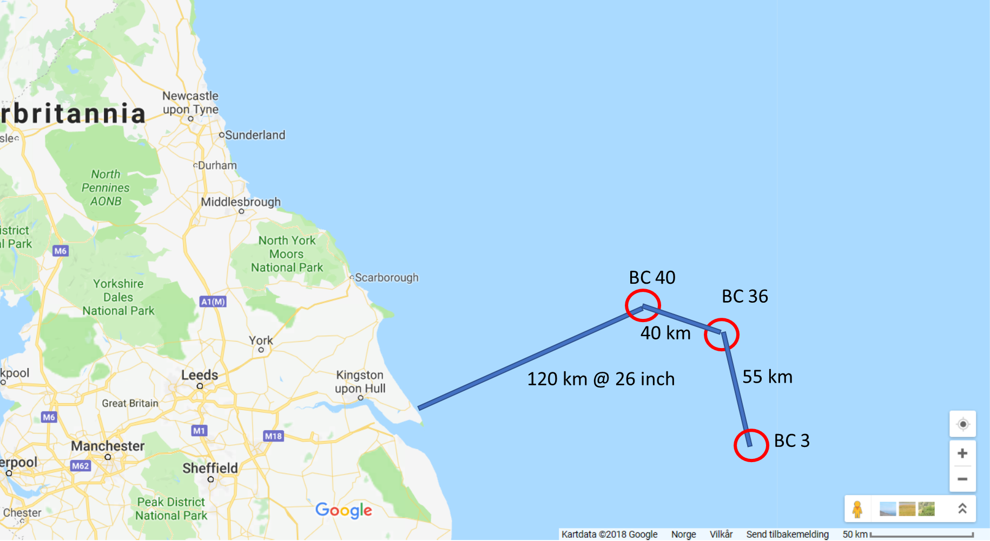
H21 NoE Commissioning – Hydrogen Supply and CCS (Equinor part)
Greenfield Hydrogen Facility
Location: Easington
Capacity: 12.15 GW
Configuration: Modular design and self sufficient with power
Hydrogen Storage
Location: Aldbrough
Capacity: 8 TWh
Configuration : 56 salt caverns at 300,000 m3
CO2 Storage
Location: Bundter
Capacity: +600 Million @ 17 mtpa
Configuration: Saline aquifers

Slide 8
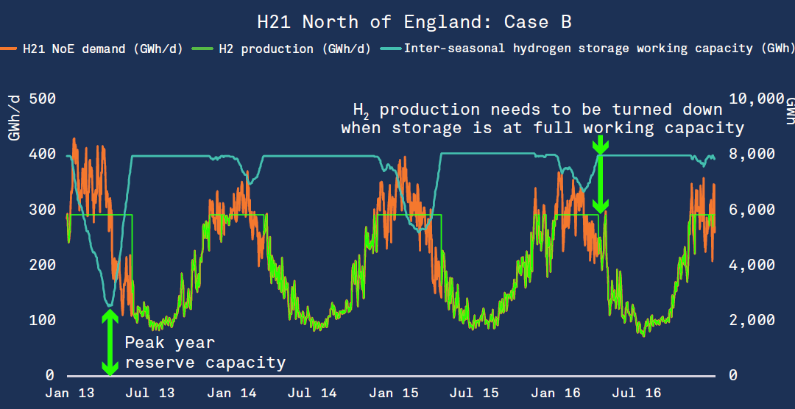
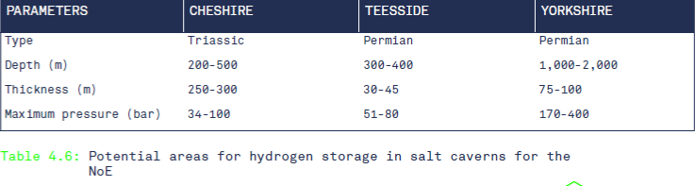
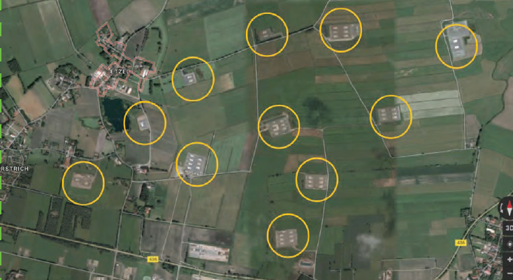
Inter-Seasonal hydrogen storage: Commissioning
Salt caverns – best suited/multiple cycles - proven
Depleted oil/gas fieds and aquifers: Strategic storage 1-2 annual cycles – not proven
Allows for optimisation of production and storage capacity

Slide 9
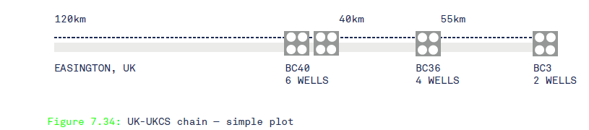
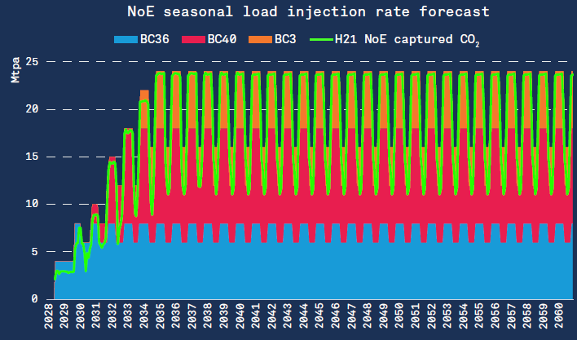
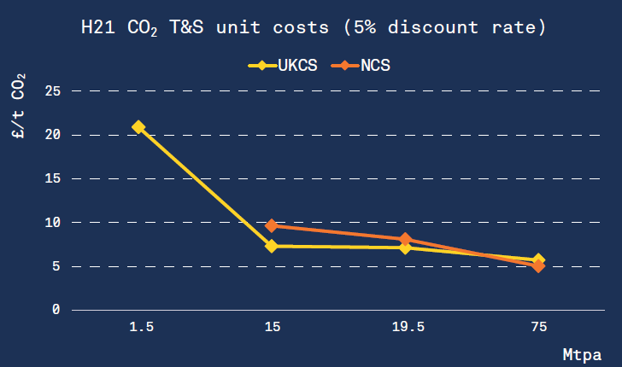
CO2 transport and storage: Commissioning and cost

Slide 10
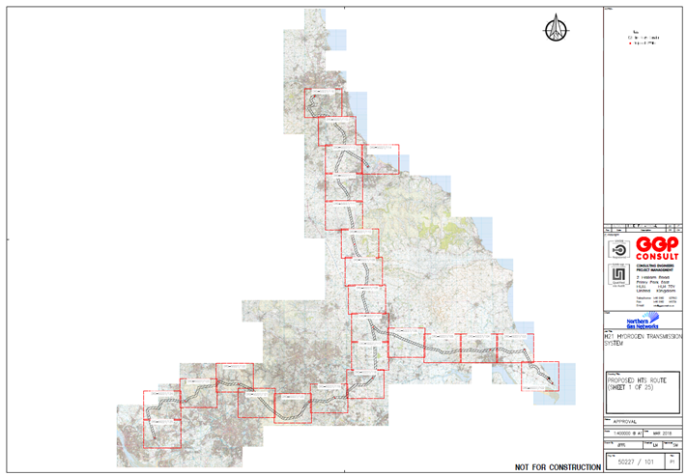
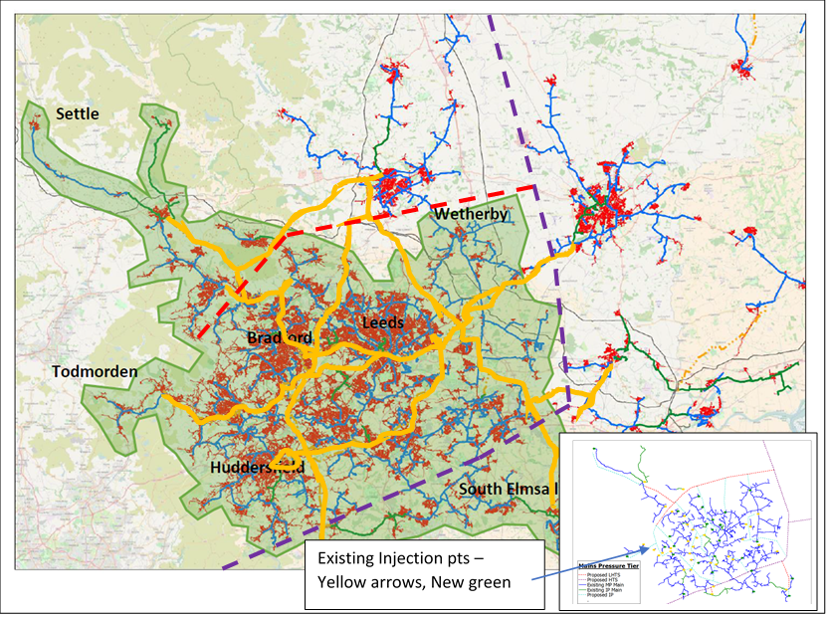
H21 NoE Commissioning – Transmission, distribution and appliances (NGN part)
Hydrogen Transport System
Pipeline length: 520 km
Capacity: 120 GW
Linepack for handling peak hour demand and daily swing

Slide 11
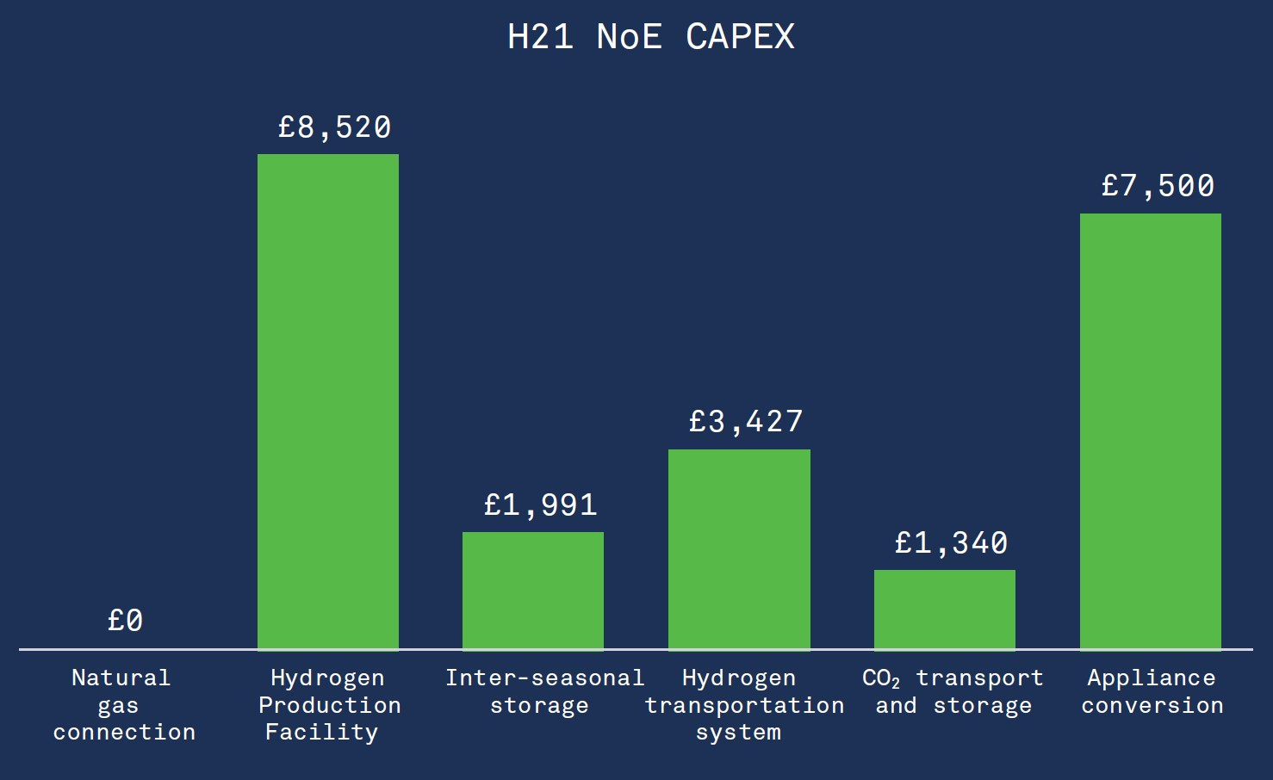
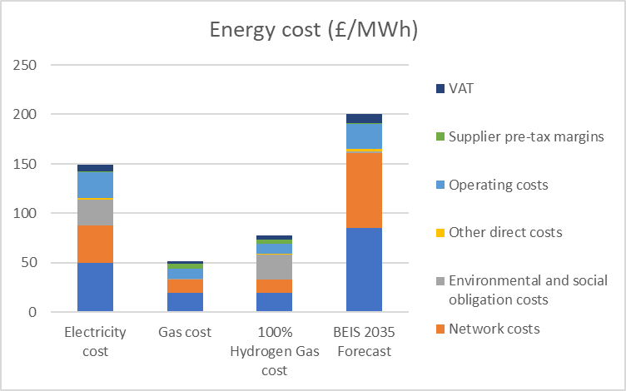
H21 NoE – Cost and finance
Gas bill increase by 50% in a H21 all UK scenario or 25 £/MWh
BEIS 2035 electricity forecast : 200 £/MWh equal increase of 50 £/MWh

Slide 12
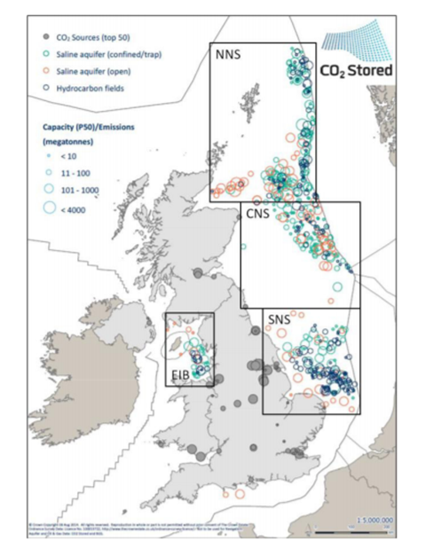
UK a future low carbon energy super power
- A potential for 6700 TWh/y of clean energy
UK’s theoretical CCS potential:
78,000 Million tonnes CO2
90 x H21 NoE in 50 years
6700 TWh/a of hydrogen
Decarbonise all European gas
Decarbonise all European road fuel
Annual revenue of £ 280 Bill
Creating millions of jobs and leading IP
Enabling the biggest market for green hydrogen and renewable energy

Slide 13
Low Carbon Solutions

